Slide 1
First Project Status Update
Prompt Engineering / Context Engineering: from Interaction to Building Applications w LLM
2026.05.12
Team 4 · WeLoveDS

Slide 2
1. Introduction of Team Members
Name | Major | Home Uni | Skills | Recent Interests | Roles
Wenhui Jin | TEMEP | Seoul National University | Python, SQL Korean, Mandarin, Japanese, English | AI impact on occupation and human skill, NLP | Team coordination, prompt improvement
Ruibo Duan | Ph.D. in Computer Science | Seoul National University | Python, algorithm design, optimization, machine learning Korean, Mandarin, English | Optimization, LLM | prompt improvement
Donghyun Ken Kim | TEMEP | Seoul National University | Python, SQL English (Native), Korean (Highly Proficient) | XAI, ML/DL, Automation with AI, OpenClaw | prompt improvement, presentation
Jia Song | Computer Science | Université de Montréal (exchange) | Python, n8n English, French, Chinese | LLM, NLP, data science | prompt improvement
Notes:
The use of the term ‘non-internal’ is a deliberate one and is intended to include both external activities(licensing, R&D contracts, outsourcing) and quasi-external activity (such as strategic alliances).

Slide 3
2. Status update - First Trial
What we try in the “student solver.py”:
A three-layer pipeline plus a fallback path:
Metric | Score | Weight
Feasibility | 0.849 | 40%
Preference | 0.850 | 30%
Adaptation | 0.901 | 20%
Efficiency | 0.420 | 10%
Student total | 0.8170
Cost / run | $0.071
Prompt layer — STUDENT_PLANNER_INSTRUCTIONS: 6 numbered rules + faithfulness clause + MEMORY_REPORT_GUIDANCE.
Planner layer — _run_planner: low-reasoning gpt-5.4-nano, 14 tool rounds, strict JSON schema, single_memory role.
Post-processing layer — _build_final: five deterministic enrichments (derive_retired_from_state, all_stale_docs, derive_spoken_rule_hits_from_state, derive_required_docs_from_state, derive_rejected_from_state) inject state-grounded facts into memory_report to align with evaluator scoring.
Fallback — _fallback_result: on RuntimeError, returns a minimal submission that still passes through Layer 3, preserving memory-metric credit.
Final numbers (verify_v1, current best)
Variance band across 3 runs: ±0.02. Ceiling: ~0.80.
Notion: First Trial Details
Github: https://github.com/KenCanCodeKinda/SNU-DataSciencePromptEngineering-FinalProject

Slide 4
Problems
Question for TA
What kind of materials should we submit for the final project? (Github link+any documents?)
Question for Professor
ask anything

Slide 5
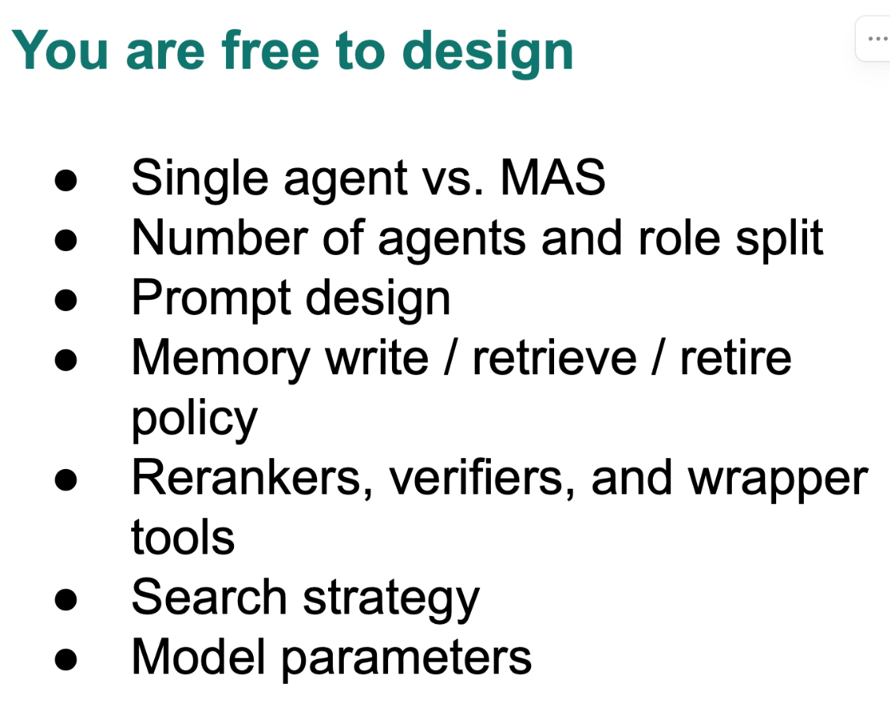
Next step
Improvement on the efficiency by updating the prompt
Change the xxxxxxxxxxxxx
Any comments will be highly appreciated!
Notes:
how the probability of an industry appearing in a province is affected by the number of related industries already pre- sent in it by constructing a network of industries, or ‘indus- try space’.
분자가 두 산업 간의 상관성을 나타낸다면, 분모는 각각의 산업 규모를 고려해서 "비교 가능한 값"으로 만들어 줌.즉, 산업 규모가 큰 경우(예: 전자제품 제조처럼 기업이 많음) 분자 값이 너무 커질 수 있으니 이를 조정해 줘.
the observed number of firms operating in industry a in province i and the expected number of firms of that industry in that province
세번째 수식: 산업 알파와 근접성이 높은 산업 베타를 어느정도 갖고 있느냐

Slide 6
Thank you!

